Slide 1
Task 4: Dashboard Design
Designed by Makkina Ramyapriya
Tool Used: Power BI
Date: 05-06-2025

Slide 2
Objective
Design an interactive dashboard for business stakeholders using Power BI.
Focus on key transaction KPIs, interactive filters, and time-based analysis.

Slide 3
Dataset Used
Transaction data including:
• Transaction ID
• Card Number
• Date Time
• Merchant Name
• Category
• Amount
• Status (Approved/Declined)
• Location

Slide 4
KPIs Created
1. Total Approved Amount
2. Total Approved Transactions
3. Declined Transaction Count
4. Average Transaction Value
5. Total Amount by Category

Slide 5
Visuals Included
- Card visuals for KPIs
- Bar chart (Total Amount by Category)
- Line chart (Approved Amount over Time)
- Pie chart (Optional: Category Share)
- Slicers for Date, Category, and Status

Slide 6
Dashboard Interactivity
- Slicers enable users to filter data by:
• Date Range
• Transaction Status
• Category
- Visuals update dynamically based on selections

Slide 7
Insights Gained
- Retail and Electronics have the highest spend
- Most transactions are approved
- Decline rate is low
- Spending is steady across time

Slide 8
Conclusion
- The dashboard allows stakeholders to analyze transaction data effectively
- KPIs and charts provide a quick overview of financial performance
- Interactivity makes it easy to filter and explore insights

Slide 9
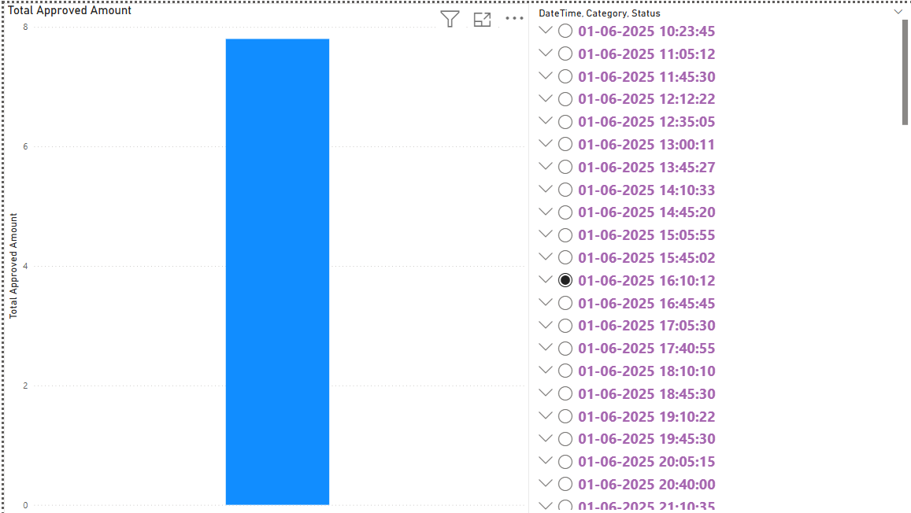
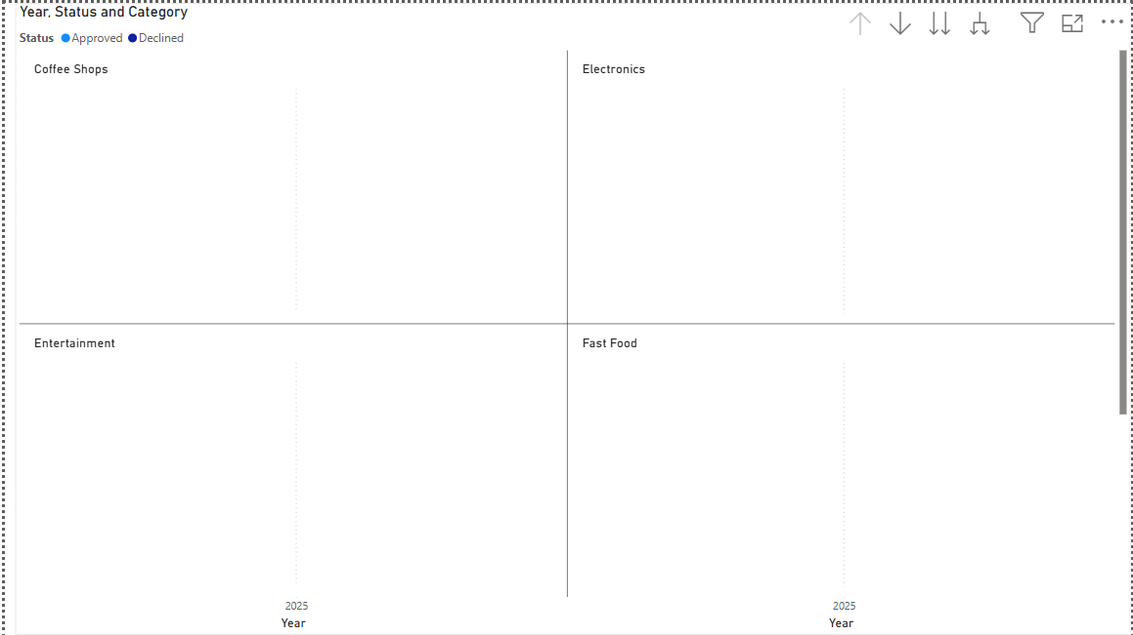
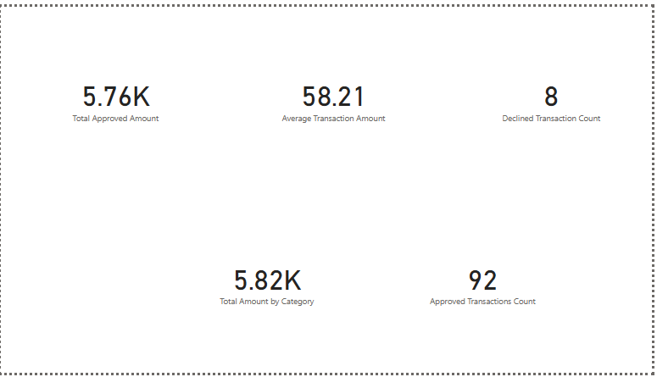
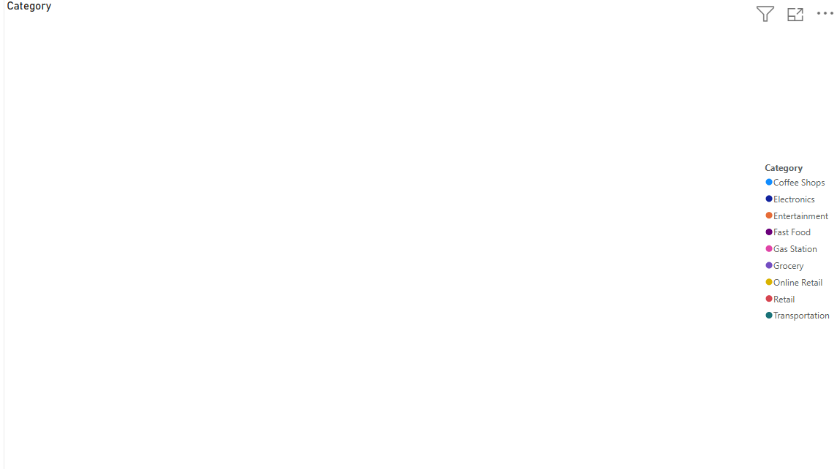
Power BI dashboard screen short here.

Slide 10
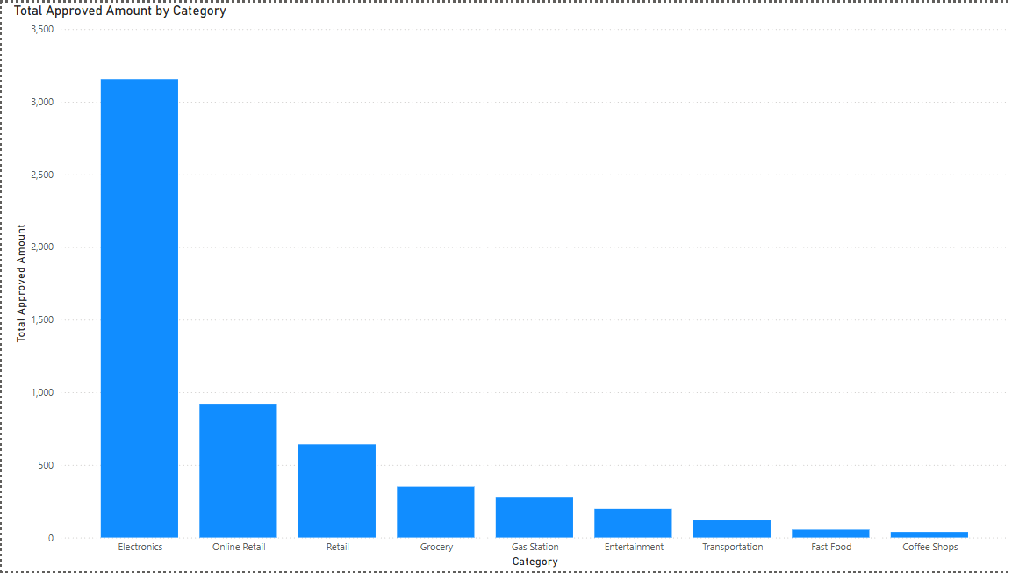
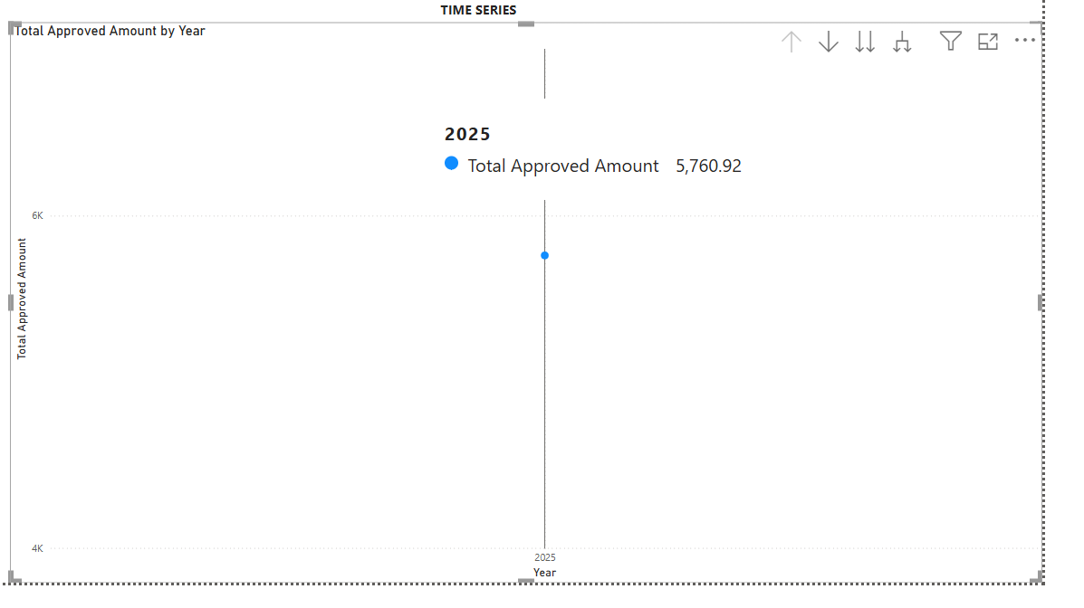
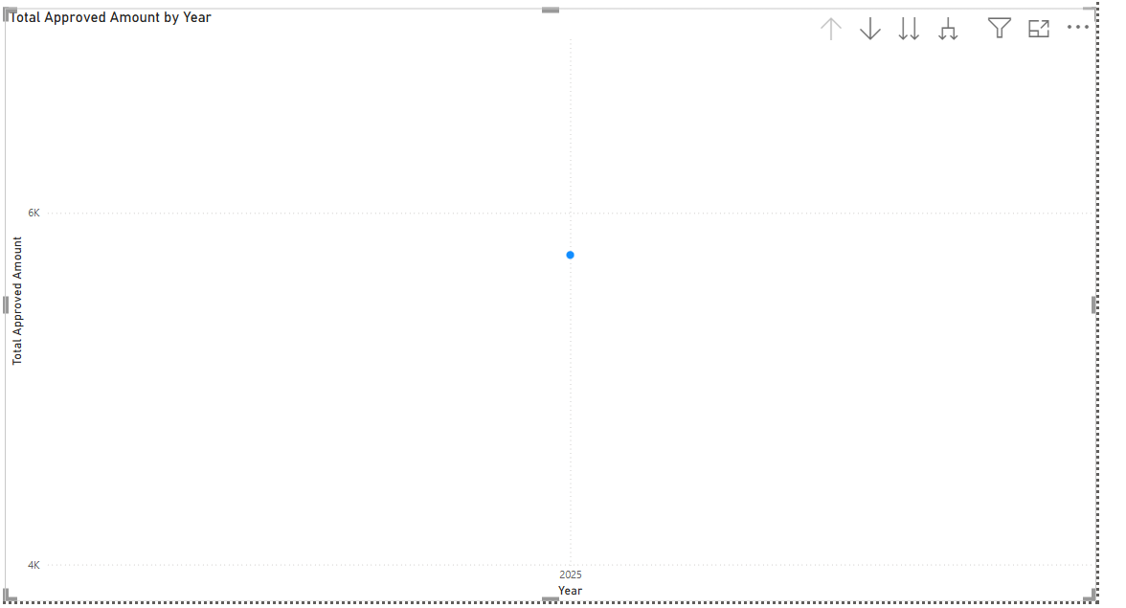
- Power BI dashboard screenshot here.

Slide 11
Thank You
Questions?
Designed in Power BI by Makkina Ramyapriya

